Slide 1
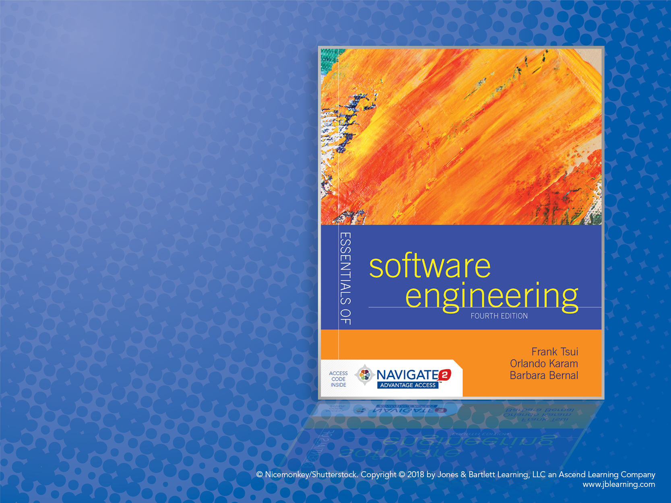
Chapter 14: Epilogue

Slide 2
Some “Contemporary” Topics
Many areas of progress since software engineering inception
Just a few of the sample progress areas:
Secure software development process
Software protection & obfuscation
Software validation & verification progress

Slide 3
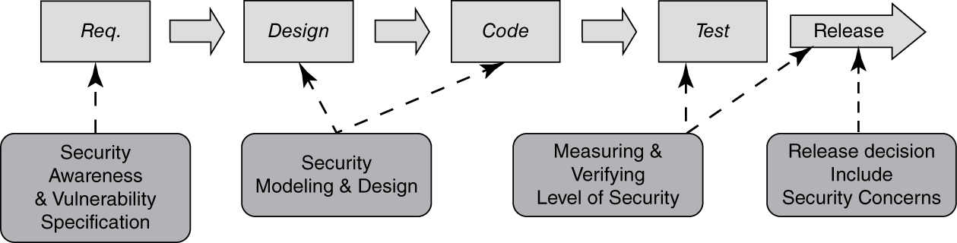
“Secure” Development Cycle
As software engineers, we need to call out security as a desired non-functional software property.
In addition, we need to include a set of activities into the software development cycle that addresses security concerns as software is developed through the traditional set of activities.

Slide 4
Software Protection
Many different techniques are being pursued.
One of the areas is software obfuscation (where we are putting complexity back into software instead):
Lexical obfuscation
Data obfuscation
Control obfuscation
Call-flow obfuscation

Slide 5
Validation/Verification Progress
From test-driven development and JUnit tool to:
“Programming by contract” and Java Modeling Language with JMLUnit tool
Behavior-Driven Development and Cucumber tool

